Slide 1
Palm Beach Preparatory Charter Academy
Title I Annual Meeting
A Collaborative Presentation
Department of Federal and State Programs and Title I Schools
Notes:
Presenter dialogue –
Welcome to [inset your school’s name] Title I Annual Meeting. Thank you for attending!

Slide 2


Purpose of Meeting
The Every Student Succeeds Act (a federal law) requires Title I schools to hold an Annual Meeting to explain and discuss the school’s Title I programs, parents’ rights, and other school requirements.
Families are encouraged to ask questions and make suggestions to help improve the school’s Title I program.
Notes:
Presenter dialogue –
According to federal guidelines, every Title I school must hold an informational Annual Meeting. The meeting allows parents and family members to better understand the importance of their role in their child’s education.
It also gives us an opportunity to ask for your input to help us improve our Title I program.
So what is Title I?

Slide 3

What is Title I?
Title I is part of a federal law that grants money to select schools to:
help meet students’ educational needs and goals,
provide staff with professional development, and
support school and family partnerships.
Notes:
Presenter dialogue –
Title I is part of the Every Student Succeeds Act (ESSA), first passed into law as the Elementary and Secondary Education Act in 1965 under President Johnson. The intent of this law was, and still is, to provide federal funds to support schools with high poverty rates to ensure that all children have the opportunity and resources to obtain a high-quality education. To this, Title I funds are used to support instruction, professional development of teachers, and family engagement programs.

Slide 4
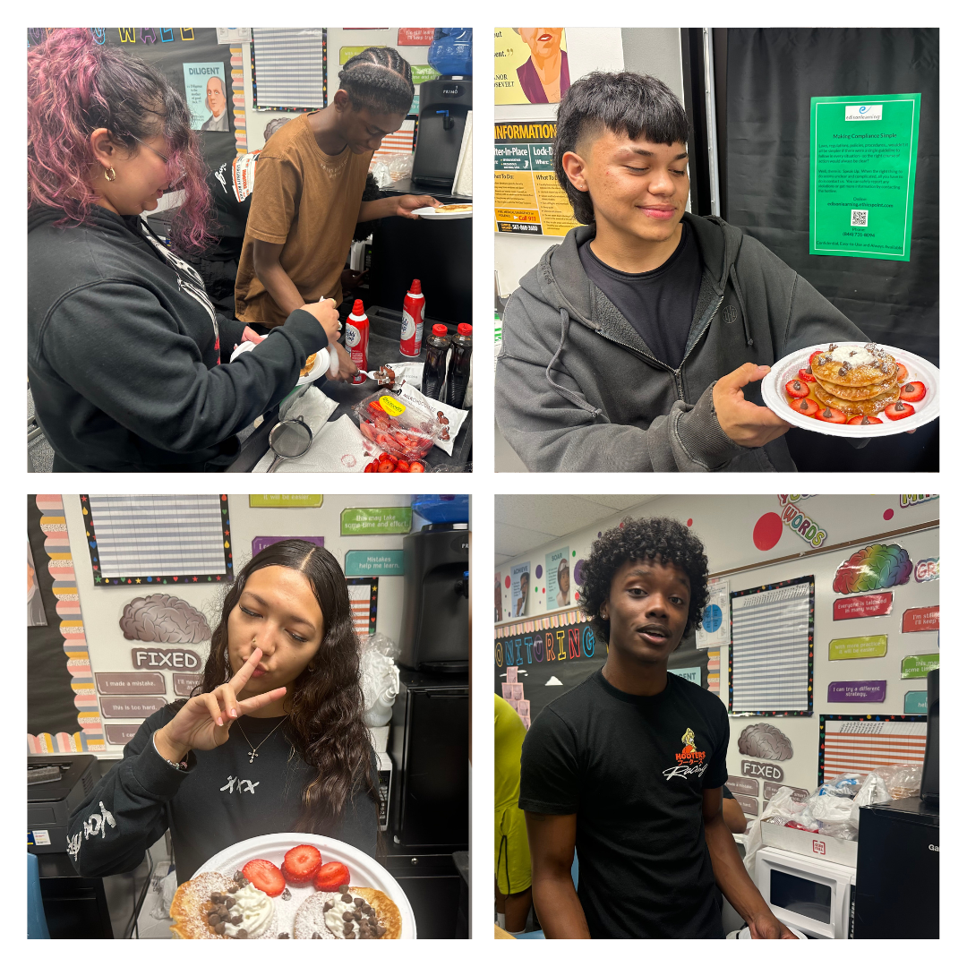
How does a school become Title I?
Eligibility for 2024-2025 School Year
  District analyzes income data (Free and Reduced Priced Lunch (FRPL), Direct Certification)
  District sets eligibility thresholds based on federal and State laws:
    70% for elementary, middle and combination schools
    67% for high schools
Notes:
Presenter dialogue –
Palm Beach County is now a Community Eligibility Provision (CEP) district meaning all students receive free breakfast and lunch. School’s qualify for Title I funding based on the percentage of students that are direct certified by the State. The more students who are eligible, the more funding the school receives. Students must fall between the ages of 5 and 17 in order to be counted in the calculation.

Slide 5
What does it mean for our School?
Additional funds to support students, teachers, and families!
  These funds are over and above what the District provides.
  Funds concentrated in instruction for students, professional development for our teachers, and activities to strengthen our partnership with families.
Notes:
Presenter dialogue –
The Title I funds are in addition to what the District provides. The funds are used to supplement and create innovative programs at our school, including support for families. In fact, a set amount must be spent on Parent and Family Engagement. Parents and family members are important stakeholders and have the right to give input into how the school will spend the funds.

Slide 6
What does it mean for our School?
Rights for Parents and Families to be informed and involved
  Title I Annual Meeting
  Decision-making Committees (Stakeholder Input Meeting)
  Parents’ Right to be Involved
  Parent and Family Engagement Plan*
  School-Parent Compact*
  Parents’ Right to Know Notifications*
  Surveys
Notes:
Presenter dialogue –
* Share these will be discussed further in the presentation.
Parents also have the right to be part of other decision-making committees like SAC and PTA (PTSO) and to request regular meetings. We will be sharing more about parents’ rights and family engagement throughout the presentation.

Slide 7

Schoolwide Title I Programs
All students benefit
All teachers benefit
All families benefit
Title I
Notes:
Presenter dialogue –
It is important to know that the School District of Palm Beach County implements the Schoolwide Title I model. This means all students, teachers, parents and family members in a Title I school benefit from the funding and services regardless of which students made the school eligible. In a schoolwide program, all students, teachers and families benefit.

Slide 8
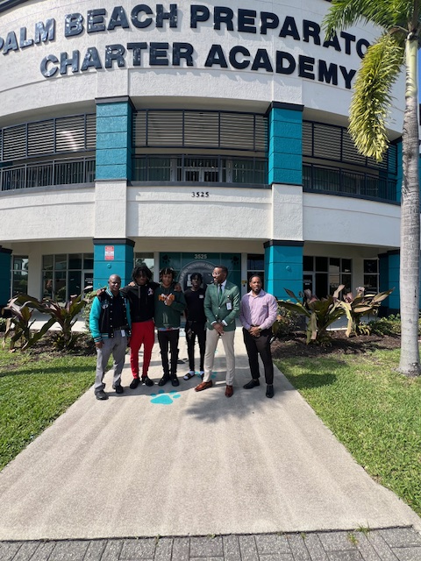
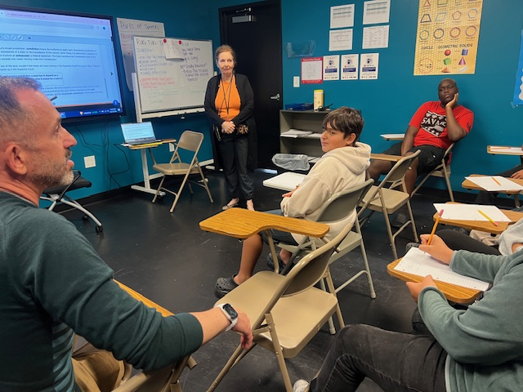
Our Schoolwide Plan (SWP)
Palm Beach Preparatory Charter Academy
Let’s review our school’s SWP
Comprehensive Needs Assessment
Activities to Support Needs
Parent and Family Engagement Plan (PFEP)
Narrative Components
Notes:
INFORMATION TO PREPARE IN ADVANCE - Customize this slide (or multiple slides – next 2 slides) Summarize your school’s SWP.
Be sure to include the data used to determine your plan (share your current Winter diagnostics assessment results and your FY24 expected outcomes).
Presenter Dialogue - Provide some details on the action steps and programs you will undertake in this school year.
Briefly touch on narrative components (main ideas).
Encourage parents to ask questions. Ask for their input. Ask specific questions to prompt discussion.
Be sure to note comments, questions, and suggestions for your Annual Meeting Minutes!

Slide 9

Title I Focus
To meet our expected outcomes, we are using this year’s Title I funds for the following:
Classroom Instruction
  Teaching position(s)
    Ms. Deana Osgood (Reading Interventionist)
    Ms. Shelia Womack (Math)
  Extended learning opportunities
    ESW Tutorial
    Saturday School
    Learning Conversations
  Technology and supplies
Why and what is the impact to student achievement?
Notes:
Customize this slide to detail what your school is doing with Title I funds this year to increase student achievement for all students.
Share details for each bulleted item.

Slide 10
Title I Focus
To meet our expected outcomes, we are using this year’s Title I funds for the following:
Parent-Family Engagement
  Parent-Family Trainings:
How will the school increase home-school communication?
What are the different academic trainings parents and families could attend?
Professional Development
  Coaching position(s):
Discuss the work they do to impact classroom instruction to increase student achievement.
Notes:
Customize this slide to detail what your school is doing with Title I funds this year to increase student achievement for all students.
Share details for each bulleted item.

Slide 11
Parent & Family Engagement
Research shows that when parents and family members are involved, students are more likely to:
  earn better grades
  do better on tests
  attend school
  adapt to change
  have better social skills
  be promoted to the next grade
  graduate
  continue their education after high school
Notes:
Presenter dialogue –
Our Schoolwide Plan involves the entire school community, including families. Researchers have studied the benefits of family involvement in schools and have found that students are positively impacted when their families are involved in their education. Students…(read bullets).

Slide 12
Parent & Family Engagement Plan
Referred to as PFEP
Describes how we involve families in students’ education
Written with the input of our school’s families and staff during the Stakeholder Input Meeting
Shared during SAC to review and revise as needed
PFEP Summaries sent home for all families
Notes:
Presenter dialogue –
We recognize the importance of partnering with families so students reap those benefits. Part of our Schoolwide Plan includes how we partner with families to help students succeed. In fact, we have an entire plan that outlines the steps we will take to strengthen our partnership with families. PFEP summaries are sent home in multiple languages.

Slide 13
Parent & Family Engagement Plan
Palm Beach Preparatory Charter Academy
Our parent engagement mission statement
How we work with parents, families and the community to increase student achievement
How we train teachers to work with families
How we support parents in helping their student(s) at home
How we share important information
Notes:
Presenter dialogue –
The plan describes how the school partners with the community, volunteers, and businesses to increase student achievement. It also outlines specific academic trainings designed for parents and family members to learn strategies they can use at home and help their children master specific foundational skills.
Share – PFEP Summary will be posted on the school website. Optional – navigate to the school’s website.

Slide 14

Parent Trainings
In alignment with the Parent and Family Engagement Plan, we would like to invite you to attend our upcoming trainings:
Palm Beach Preparatory Charter Academy
Name and Date of Training #1
Name and Date of Training #2
Name and Date of Training #3 (ES only)
Notes:
Customize this slide to detail what your school is doing with Title I funds this year to increase student achievement for all students.
Be sure to include learning outcomes for parents and share what they can expect to learn from attending these interactive trainings.
Optional = Ask parents to enter these dates in their phone/calendar as save the date.

Slide 15

School-Parent Compact
Each Title I school must have a School-Parent Compact that is written by parents, family members and school personnel.
The School-Parent Compact sets out the responsibilities of the students, parents, family members, and school staff in striving to raise student achievement.
Notes:
Presenter dialogue –
An important part of the Parent and Family Engagement Plan is our School-Parent Compact. The Compact is also developed jointly with parents, family members and staff and outlines the responsibilities each have to raising student achievement.

Slide 16
School-Parent Compact
Review of FY25 School-Parent Compact
Suggestions for next year’s Compact
Questions
Notes:
Share your school’s final Compact.
Share with parents:
the importance of the School-Parent Compact
how it was developed and
how it is going to be used to impact student achievement
the Compact will be revisited during ELEMENTARY parent-teacher conferences (as required by law)

Slide 17

Parents’ Right to Know
Families have the right to ask:
  about the professional qualifications of their child’s teachers; and
  if non-teacher personnel are providing instruction to their child and, if so, their professional qualifications.
Notes:
Presenter dialogue –
Title I schools must inform parents and family members of their rights. Parents and family members have the right to request information regarding their child’s teachers and paraprofessionals’ qualifications and their child’s academic level and growth on State assessments.

Slide 18
Parents’ Right to Know
Families must be informed:
  if their child is taught for four or more weeks by a teacher who does not meet the certification requirements for the grade level or subject being taught; and
  how their child performed on state tests like FSA, EOCs, and SSA.
Notes:
Presenter dialogue –
Parents must be notified if their child has been taught for four or more weeks by a teacher who is licensed to teach in the State of Florida, but does not hold a certificate to teach the grade or subject listed above.
Parents must also be notified if their child has been taught for four or more weeks by a substitute teacher who is approved by the District to substitute teach, but does not hold a Florida Department of Education teaching certificate for the grade level or subject listed above.
School must share with parents their child’s assessments results (FSA, EOC and SSA).

Slide 19


Migrant Education Program (MEP)
The GOAL of the MEP is to assist all migrant students in meeting challenging academic standards and achieving graduation from high school (or a GED program) with an education that prepares them for responsible citizenship, further learning, and productive employment.

Slide 20

Migrant Education Program
Ensure the needs of migrant students are met to help them overcome:
  interruption in schooling
  cultural and language barriers
  social isolation
  lack to health resources
  transition to college or work after high school
To improve educational opportunities of migrant students by helping them:
  Supplemental academic/social services to students and their families
  Transition to new school(s)
  meet the challenging state/district academic content
  graduate from high school
Notes:
Presenter dialogue –
The program provides supplemental academic and social support to migrant students and their families.

Slide 21
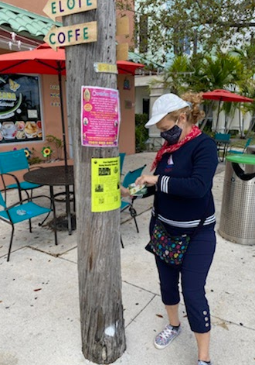

First step is to find all migrant students
Interviews are done in person by a training MEP Recruiter using Federal & State eligibility requirements
Program Contact Information:
Jorge Echegaray
Manager, Migrant Education Program
Multicultural Education Department
Jorge.Echegaray@palmbeachschools.org
(561) 202-0356

Slide 22
Students Experiencing Homelessness
Every Student Has the Right to an Education
The McKinney-Vento Homeless Education Program (MVP) Team can help students and families who live:
  in a shelter, motel, vehicle, or campground;
  on the street;
  in abandoned buildings or substandard housing;
  in motels/hotels; or
  doubled-up temporarily with relatives or friends due to a hardship
Notes:
Presenter dialogue –
In addition to the services that we provide to the migrant students, do you know that our District also provides support and services to students experiencing homelessness, including unaccompanied homeless youth? Unaccompanied homeless youth are homeless youth not in the physical custody of a parent or guardian.

Slide 23
Students Experiencing Homelessness
Every school has a McKinney-Vento Contact Person & assigned McKinney-Vento Program (MVP) Case Manager who works with families to:
provide school supplies, uniforms, supplemental services and free school meals;
set up transportation to and from the school of origin;
find community support and resources;
decide which school would be best for the child (the school of origin, or the zone school);
communicate with the school;
and so much more.
Notes:
Presenter dialogue –
Every effort is made to address the needs of students and families experiencing homelessness. Families can contact the school to find more information on the services the school and District provide.

Slide 24
Students Experiencing Homelessness
MVP Contact Information
Contact the McKinney-Vento Homeless Education Program (MVP) if you have questions or to complete a Student Housing Questionnaire
  (561) 350-0778
  MVPhomeless@palmbeachschools.org
  MVP Website

Slide 25
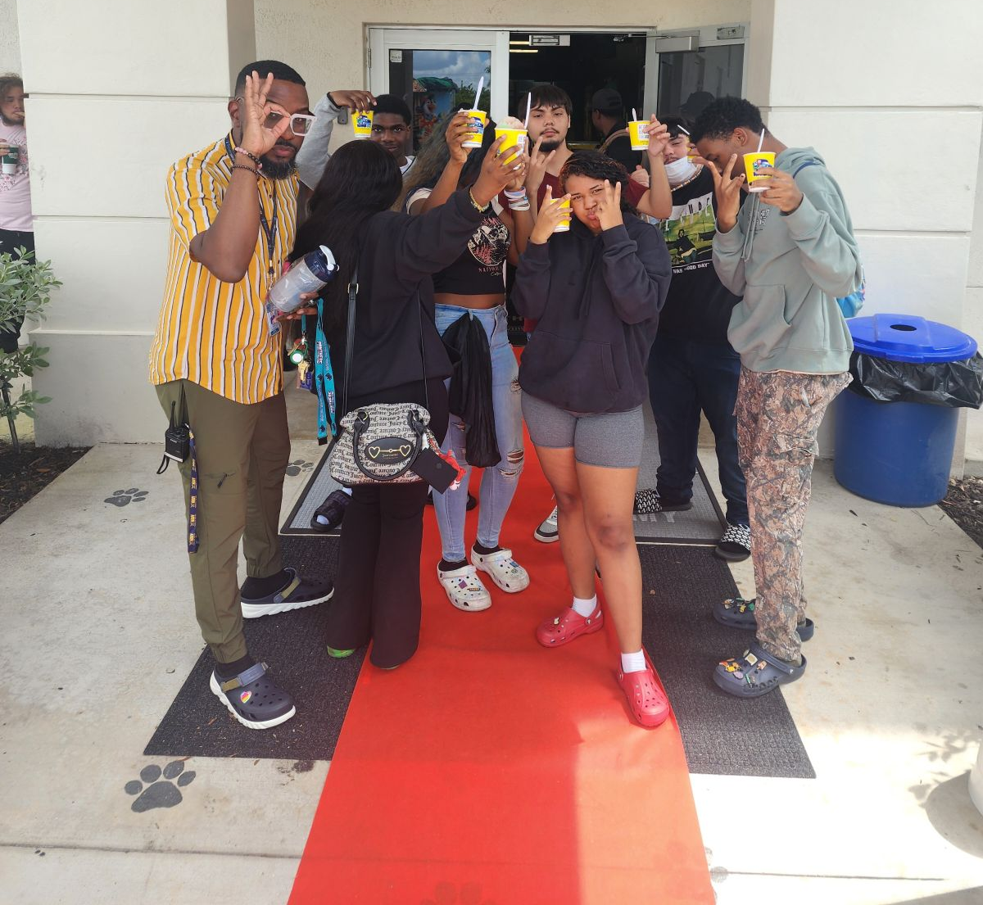
Conclusion
Parents’ opportunity to ask questions and provide feedback
Complete evaluation
Thank you for your attendance, participation, and feedback.
We look forward to a successful school year!
Notes:
Presenter dialogue –
Ask if there are any questions.
Ask participants to complete evaluation using the link posted to school website under Annual Meeting.
Thank participants for attending.

